Slide 1
Bringing light to color
The psychological effects of color theory when applied to environmental lighting.
By Jennifer Huff

Slide 2
Overview
Define key terms:
Color theory, Color Psychology
Why color theory?
Research involved
Show and tell
Testing and Data
My opinionated conclusion

Slide 3
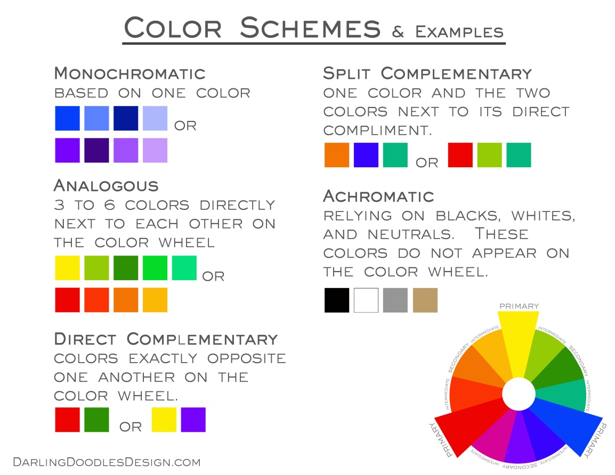
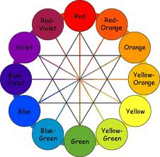
Bridging the gap
Every color can rouse an emotional response, though knowing the unspoken language is a key factor in being able to use it constructively - A. Kargere.
Color Theory
A collection of guidance to color mixing.

Slide 4
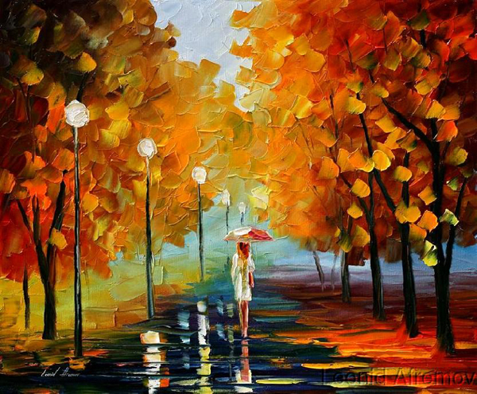
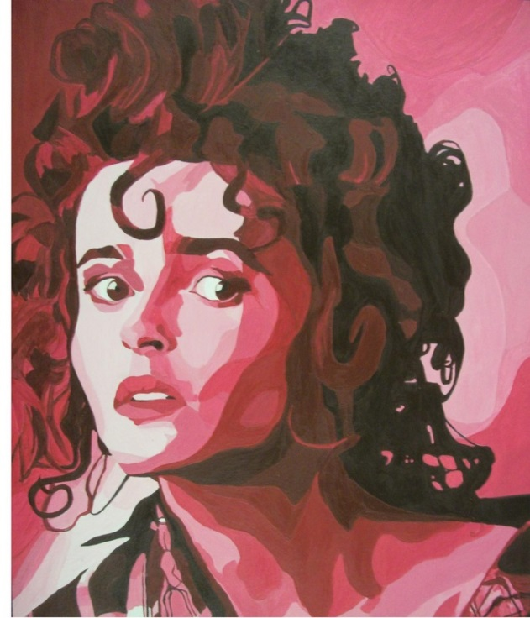
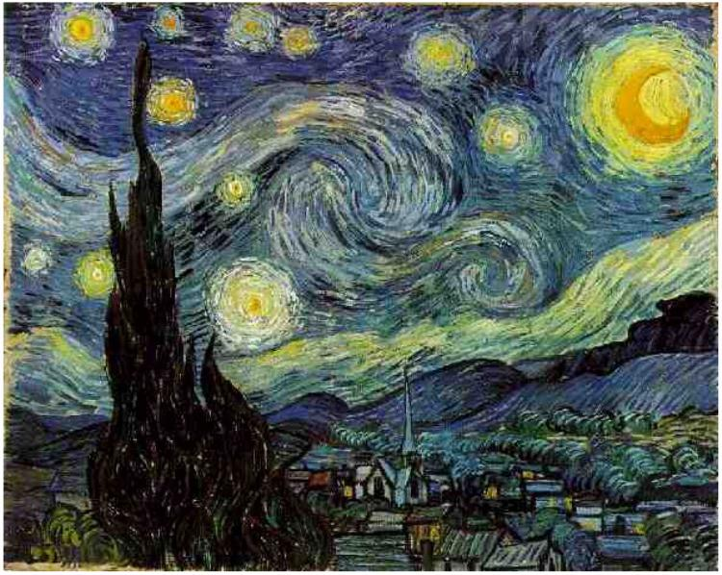
You will never know its there

Slide 5
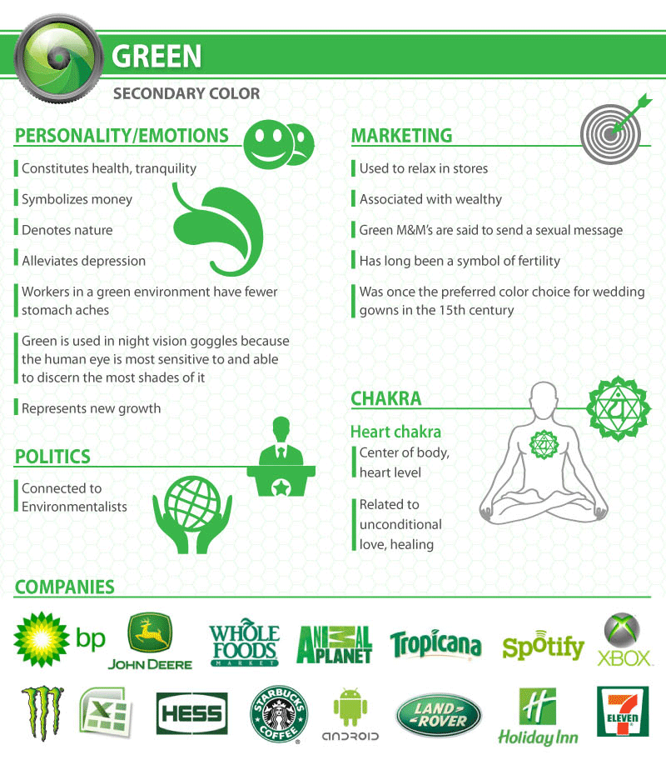
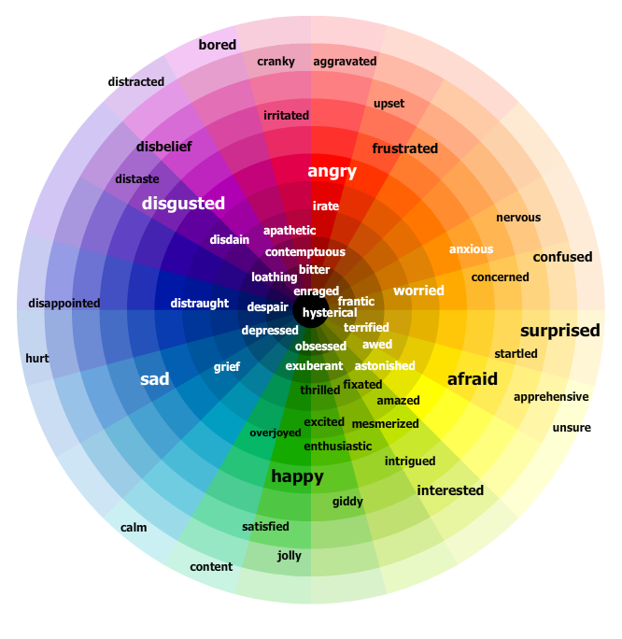
How does that make you feel?
Color Psychology
The study of color and its effects on human emotions.

Slide 6
The people and books
Research
Color | Associations
Red | Danger, anger, rage, hate, war, blood, excitement, tension, power, health, vigor, warmth, friendship, love
Orange | Wholesomeness, wisdom, justice, warm, intimate, joy, ambition, happy, cheerful, lively, exciting, passive, mellow, energetic
Yellow | Neutral, safety, cheerful, joy, caution, celestial, health, intelligence, coward, deceit, treachery, active, aspiring, relaxing, pride
Green | Jealousy, poison, malnutrition, nature, sympathy, deceit, charity, hope, spring, tranquil concentration, mediation, health, death, pleasing, quieting, refreshing, peaceful, ghastly, disease, terror, guilt
Blue | Bleak, restful, tragedy, spiritual, cold, melancholy, gloom, fearfulness, relaxed, quiet, cold, insane, mental depression, recessive, distant, mournful, good, empty, pleasure, peace, devotion, security, loyalty, truth, healing, calming, soothing
Purple | Royalty, spirituality, angelic, love, purifying, calming, coolness, soothing, tragedy, power, melancholy, mystical, dignified, darkness, shadow, mournful, loneliness, desperation
F. Birren, “Color Psychology and Color Therapy,” 2ndEd,
A. Kargere, “Color and Personality,”
Stephen J. Sidelinger, “Color Manual.”
“Color theory”, wikipedia.com.

Slide 7
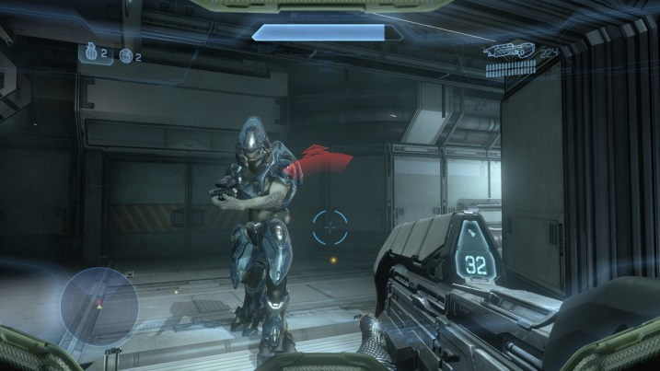
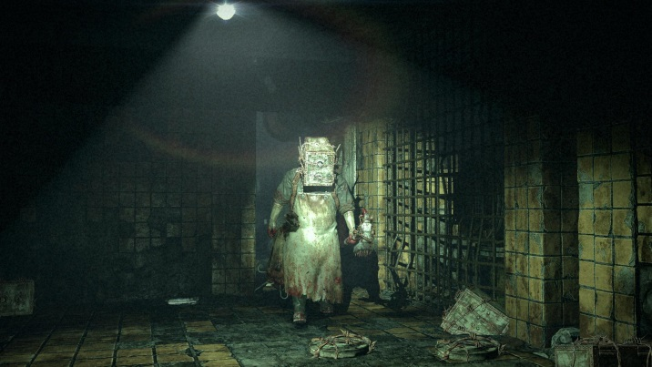
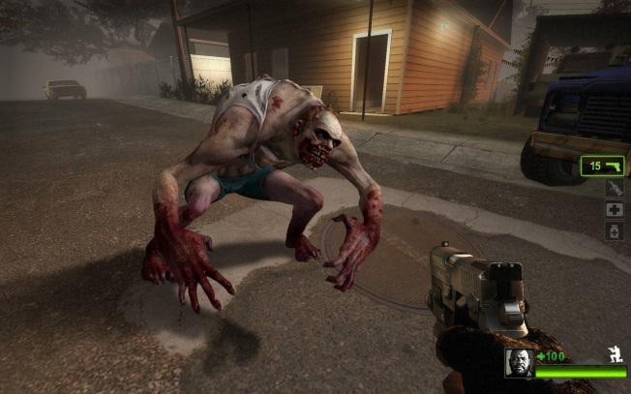
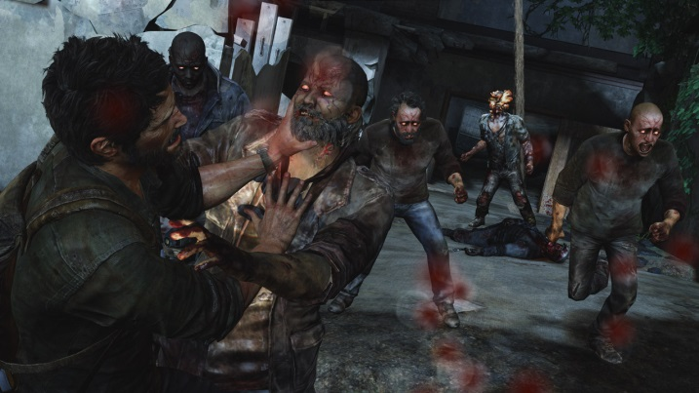
Why Color theory?
# 1 reason. White lit games.
They could invoke more emotions…
#2… its always been an interesting subject in my life.

Slide 8
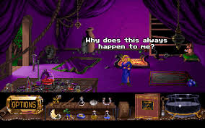
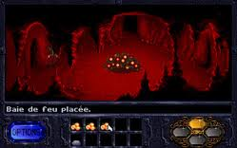
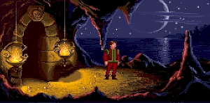

Slide 9
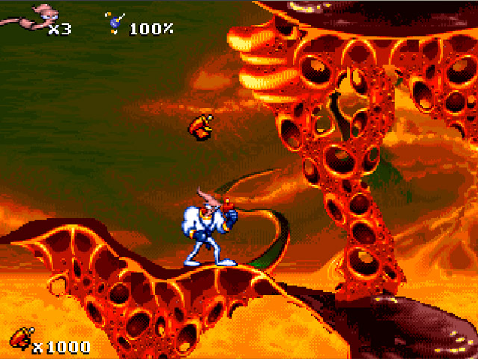
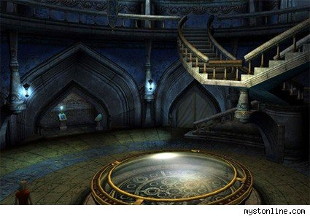
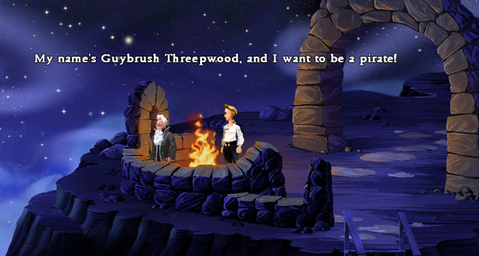
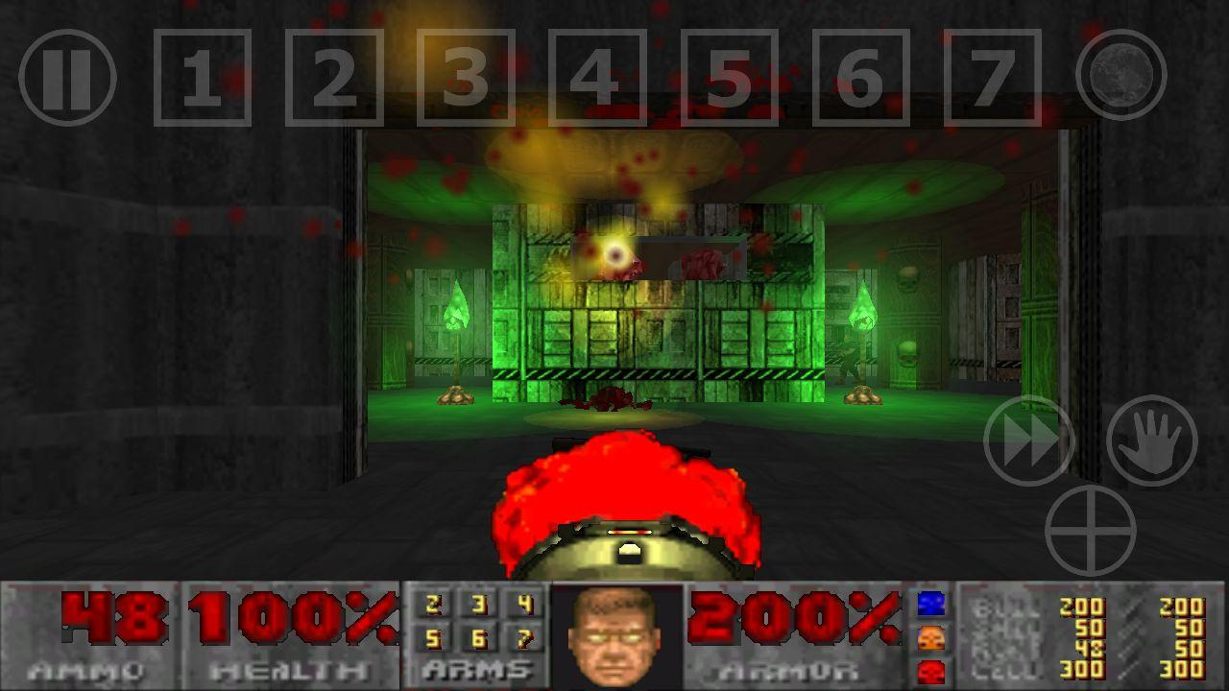

Slide 10
The testers
82 people tested
20 female.
62 males.
Most of the participants were 18-30 years of age.
There was a small percent from 31-35.
A single person 40+.
Everyone got white, and one color.
Explore and find the wallet.

Slide 11
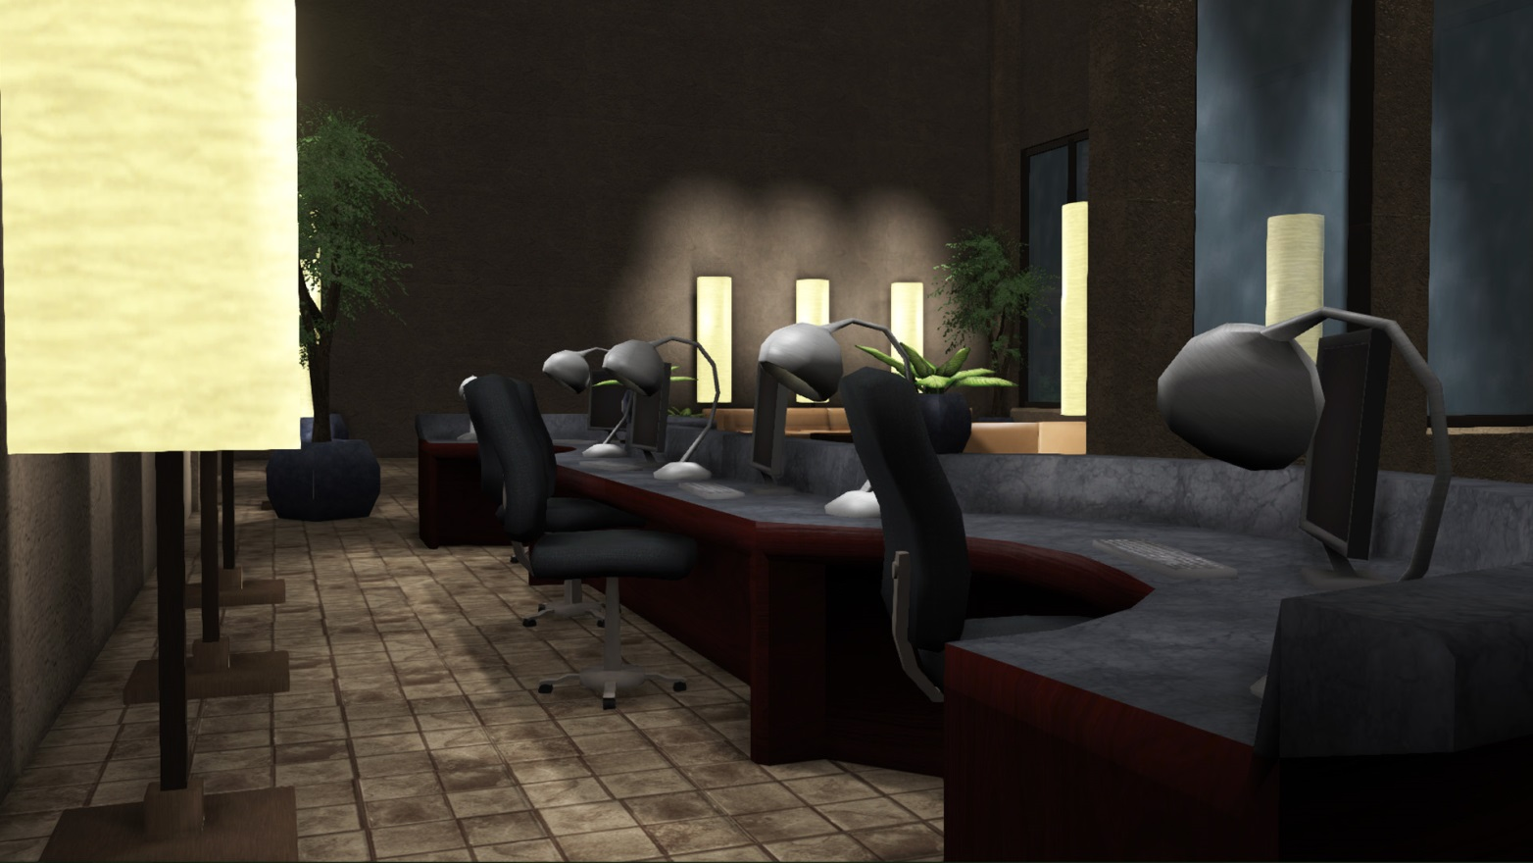
Soul Harvesting
If you build it… they will test…

Slide 12
The questions
The Generic ones…
The important ones…
Age?
Sex?
How many hours do you play games?
What kind games?
Are you color blind?
What is your favorite color?
What color was the Lighting in the Environment?
Did you find the environment itself to be Neutral?
The point of this study.
What emotions did you experience while playing through this level?
scared cheerful neutral cautious hopeful relaxed
depressed angry melancholy cold warm fearful
soothing desperate lonely mystical powerful excited
mellow secure curious creepy comfortable helpless
stressed anxious uncomfortable

Slide 13
Souls have emotions

Slide 14
What the data means
Participants were offered a list of 27 emotional associations to select from.
This table summarizes the probabilities that resulted.
White = expected vs colored results.
No two colors will make you feel the same.
I’ll take a Chi Square chart please…
 | White | Red | Orange | Yellow | Green | Blue | Purple
White | - | .0001 | .0001 | .0001 | .0001 | .0001 | .0001
Red | .0001 | - | .0001 | .0001 | .0001 | .0001 | .0001
Orange | .0001 | .0001 | - | .0001 | .0001 | .0001 | .0001
Yellow | .0001 | .0001 | .0001 | - | .0001 | .0001 | .0001
Green | .0001 | .0001 | .0001 | .0001 | - | .0001 | .0001
Blue | .0001 | .0001 | .0001 | .0001 | .0001 | - | .0001
Purple | .0001 | .0001 | .0001 | .0001 | .0001 | .0001 | -

Slide 15
The Blank Slate
82 people tested
Neutral 17.44%
Relaxed 14.83%
Comfortable 10.47%

Slide 16
The beginning of the Rainbow
Danger, anger, rage, hate, war, blood, excitement, tension, power, health, vigor, warmth, friendship, love
15 people got red.
Caution 15.87%
Creepy 14.29%
Anxious and warm 9.52%.
Generally interpreted emotions that are negative

Slide 17
Wholesomeness, wisdom, justice, warm, intimate, joy, ambition, happy, cheerful, lively, exciting, passive, mellow, energetic
15 people got red.
Warm 14.29%
Caution 12.50%
Curious and fearful 8.93%.
A strong range of variances.

Slide 18
Neutral, safety, cheerful, joy, caution, celestial, health, intelligence, coward, deceit, treachery, active, aspiring, relaxing, pride
15 people got yellow
Curious and warm 12.00%
Neutral and excited with 8.00%.
A color of comfort, invoking a sense of safety or hope.

Slide 19
Jealousy, poison, malnutrition, nature, sympathy, deceit, charity, hope, spring, tranquil concentration, mediation, health, death, pleasing, quieting, refreshing, peaceful, ghastly, disease, terror, guilt
15 people got Green
Caution at 24.39%
Curious 14.63%
Creepy at 12.20%
Negative connotations… deceit, poison and disease, or curiously mystical?

Slide 20
Bleak, restful, tragedy, spiritual, cold, melancholy, gloom, fearfulness, relaxed, quiet, cold, insane, mental depression, recessive, distant, mournful, good, empty, pleasure, peace, devotion, security, loyalty, truth, healing, calming, soothing
14 people got Blue
Cold 14.06%
Mellow 10.94
Caution and lonely 9.38%
A negative reaction towards the environment, most of which in a passive way.

Slide 21
Royalty, spirituality, angelic, love, purifying, calming, coolness, soothing, tragedy, power, melancholy, mystical, dignified, darkness, shadow, mournful, loneliness, desperation
14 people got Purple
Caution 18.64%
Creepy, mystical 11.86%
Curious at 10.17%
Purple does not actually hold strong to his roots and is better interpreted as a color with a dichotomy.

Slide 22
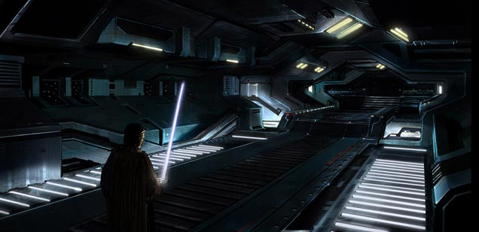
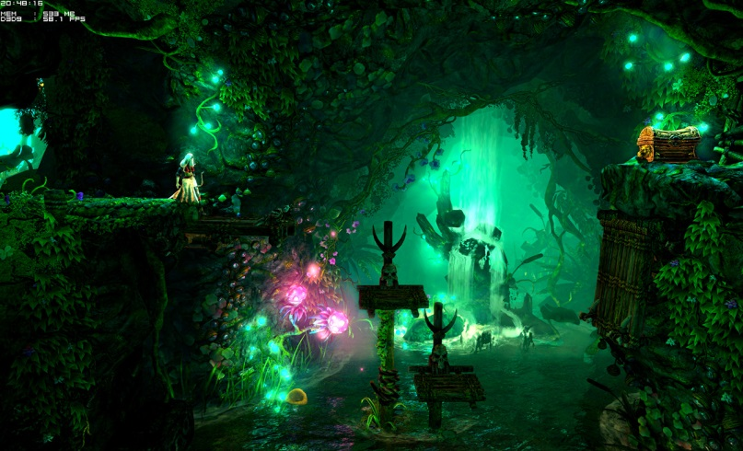
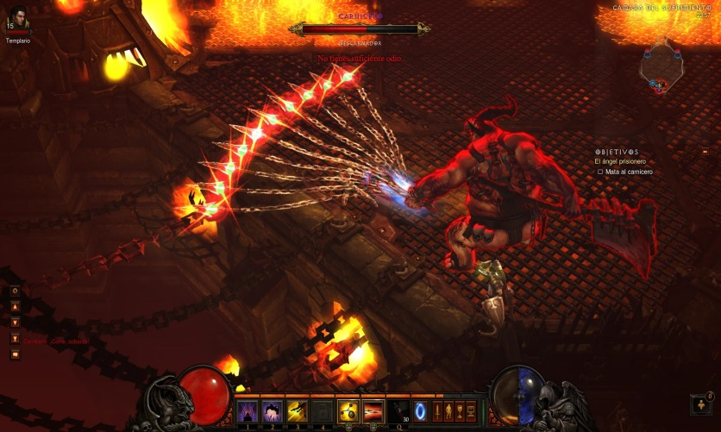
What all this means
Color invokes emotions
White lighting
Colored lighting
Use it to your advantage

Slide 23
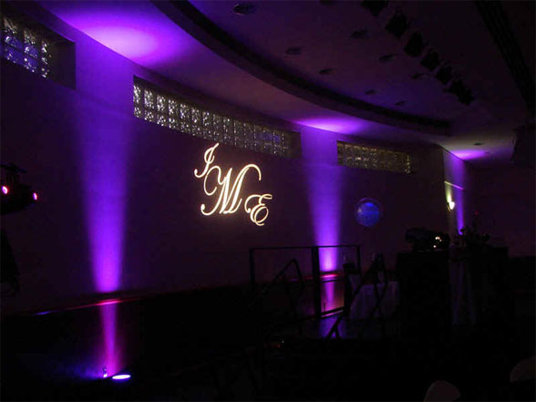
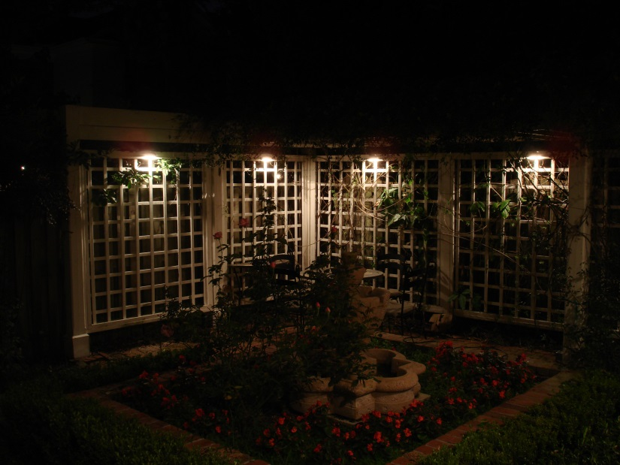
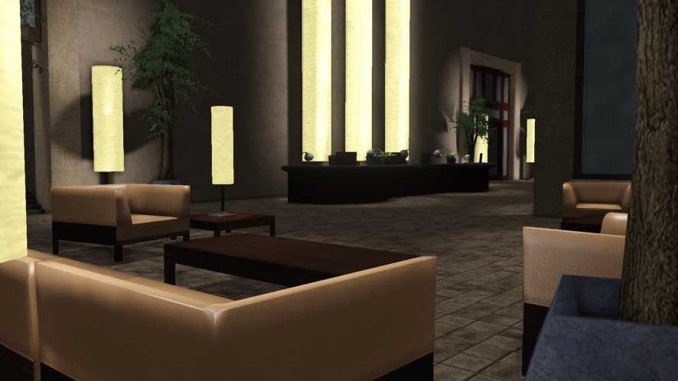
Experiment with schemes
Up lighting
Down Lighting
Spot Lighting

Slide 24
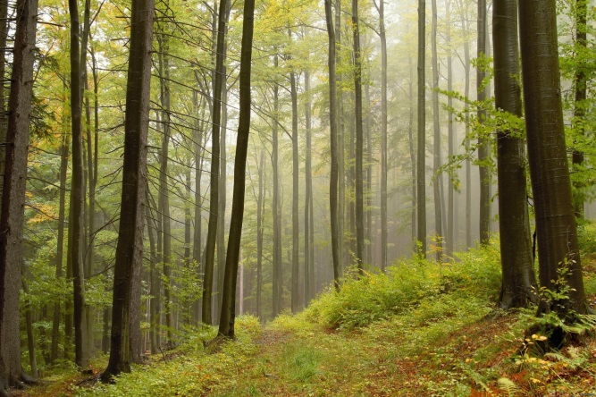
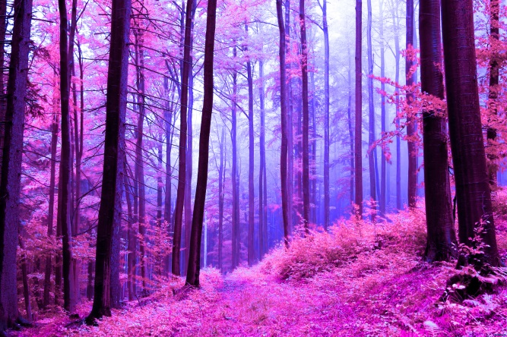
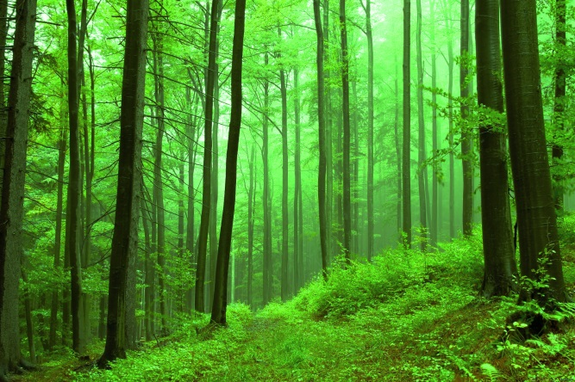
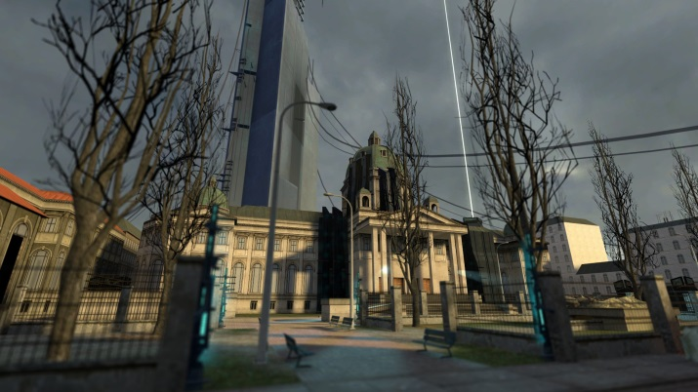
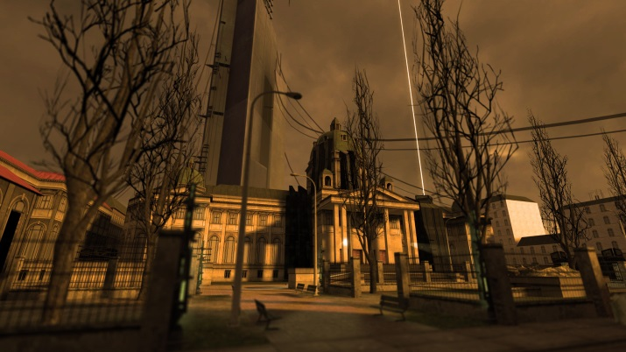
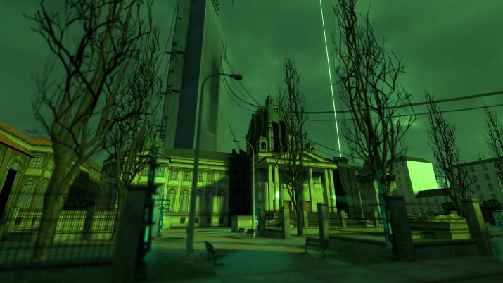
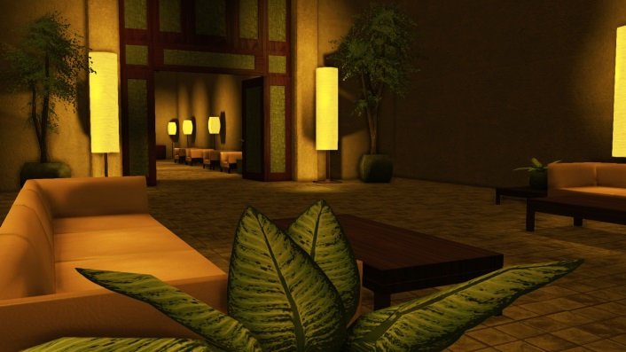
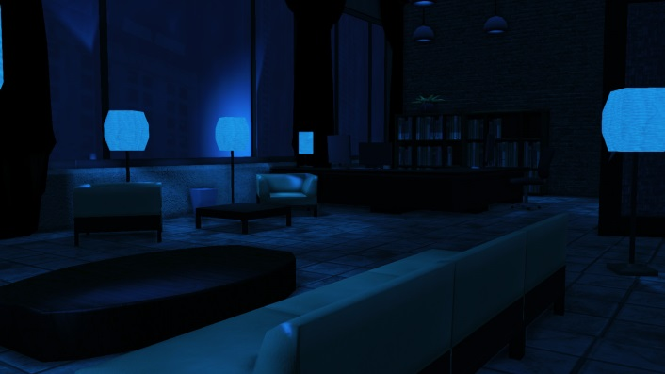
Experiment with settings

Slide 25
